Slide 1



Conservation decisions with
exact algorithm solvers
Jeffrey Hanson
jeffrey.hanson@uqconnect.edu.au
jeffrey-hanson.com

Slide 2
Now
Biodiversity
Status quo
2000
Future

Slide 3
Now
How do we
get here?
Biodiversity
Status quo
2000
Future

Slide 4



How do we bend the curve?
Ecological surveys
Distribution maps
Priority areas
Biodiversity
2000
Future
Data
Information
Plan
Outcome

Slide 5
How do we bend the curve?
Ecological surveys
Distribution maps
Priority areas
Biodiversity
2000
Future
Data
Information
Plan
Outcome
Prioritization

Slide 6
Framing conservation as a decision science problem
Goal: what is our vision for the future?
Objective: what quantity are we maximizing/minimizing to help achieve the goal?
Constraints: what things must our solution do to help achieve the goal?
Decisions: what actions could we do to maximize/minimize the objective?

Slide 7





Heuristic
algorithm
Meta-heuristic
algorithms
Exact
algorithms
Estimate of best quality
Quality
Different
solutions
Different
solutions
Different
solutions
PPP

Slide 8
Exact algorithm solvers
Open source and commercial solvers available (e.g., Gurobi, IBM CPLEX, CBC, HiGHS, SYMPHONY)
Automatically select algorithms for different problems (e.g., presolve, simplex, barrier, branch-and-bound)
Broadly speaking have similar functionality, but have different implementations of the underlying algorithms, and have different performance for different kinds of problems
See here for explanation of branch and bound algorithm: https://www.youtube.com/watch?v=CdfZ4XOpSho

Slide 9
Exact algorithm solvers
Solve multiple problem types:
linear programming (LP) = continuous decision variables
integer programming (IP/ILP) = binary/integer decision variables
mixed integer linear programming (MILP) = continuous + binary/integer decision variables

Slide 10
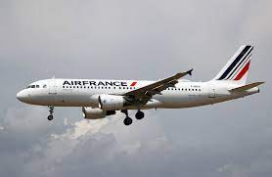

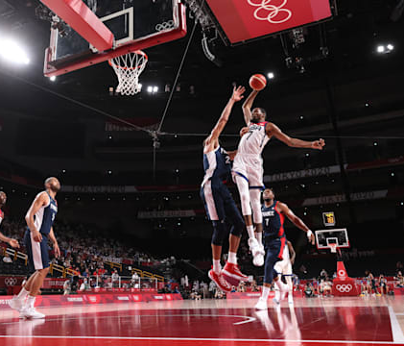
Case studies
Scheduling plane flights to reduce fuel and operational costs
Keeping ATMs stocked with cash, while minimizing costs
Basketball game schedules
For more examples, see https://www.gurobi.com/case_studies/

Slide 11
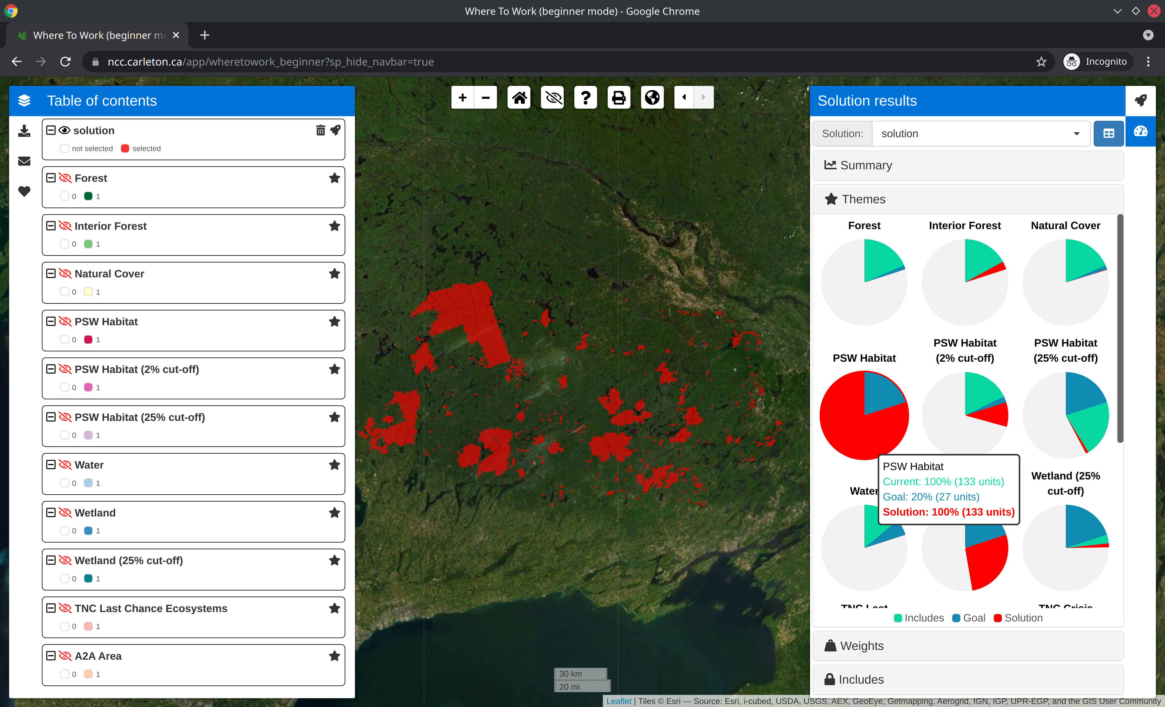
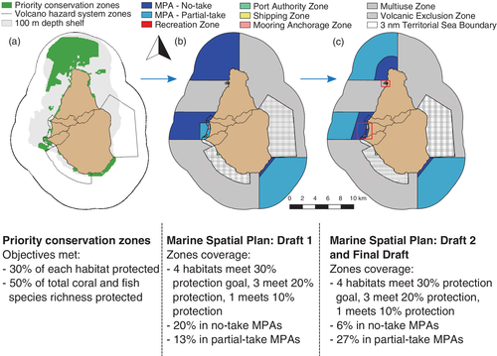
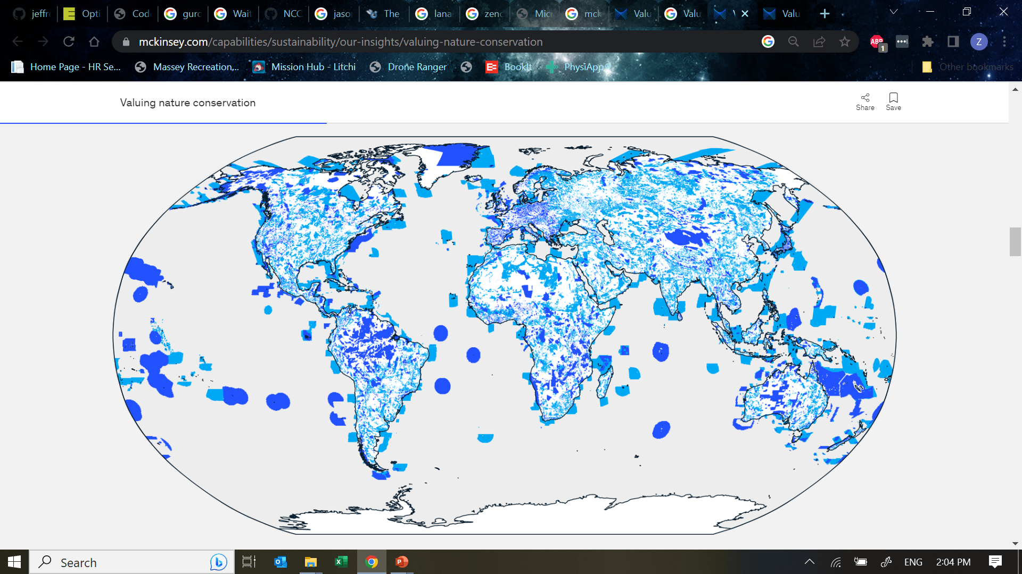
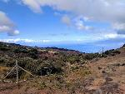
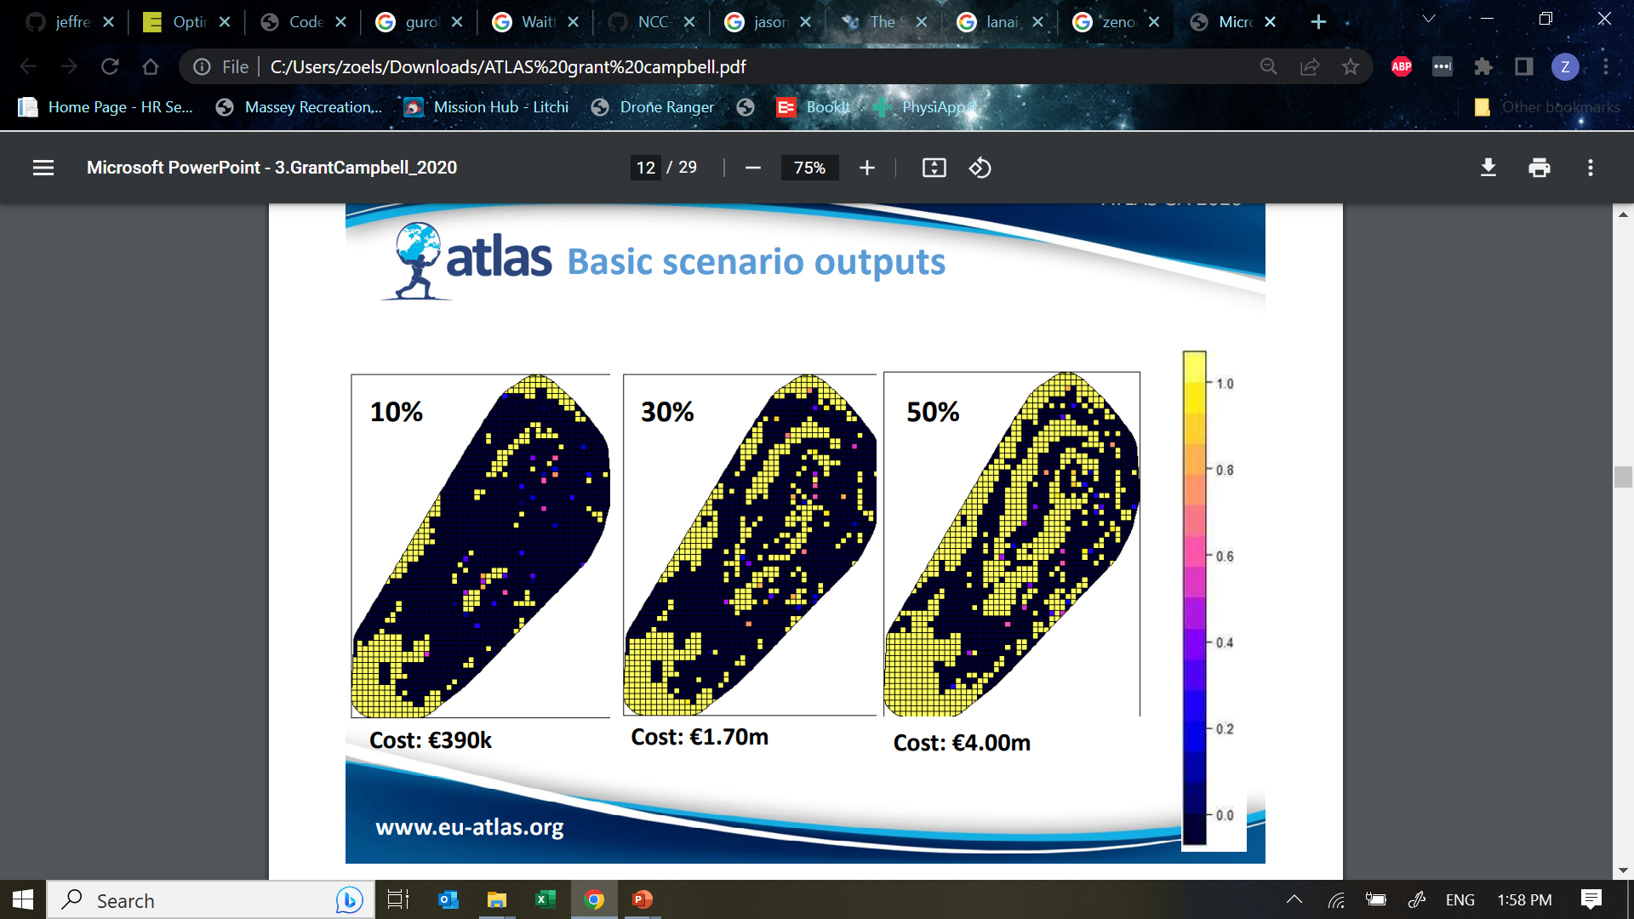
Conservation examples
McKinsey Consulting
Nature Conservancy of Canada for land acquisition
Waitt Institute to help Government of Montserrat
Scottish Government for marine spatial planning in Rockall Bank
USGS to prioritize recovery areas in Hawaii

Slide 12





Reserve selection as optimization
Goal: conserve biodiversity
Objective: min. # of islands
Constraints: sufficient habitat for each species
Decisions: create a reserve on an island or not?

Slide 14
1
2
3
4
5
6
7
8
9

Slide 15
1
2
3
4
5
6
7
8
9
1
2
3
4
5
6
7
8
9

Slide 16
1
2
3
4
5
6
7
8
9

Slide 17
Min €:
+1
+1
+1
+1
+1
+1
+1
+1
+1
1
2
3
4
5
6
7
8
9

Slide 18
2
Min €:
+1
+1
+1
+1
+1
+1
+1
+1
+1
1
2
3
4
5
6
7
8
9

Slide 19
Min €:
+1
+1
+1
+1
+1
+1
+1
+1
+1
1
2
3
4
5
6
7
8
9
+1
+1
1
2
3
4
5
6
7
8
9

Slide 20
Min €:
+1
+1
+1
+1
+1
+1
+1
+1
+1
1
2
3
4
5
6
7
8
9
+1
+1
+1
1
2
3
4
5
6
7
8
9

Slide 21
Min €:
+1
+1
+1
+1
+1
+1
+1
+1
+1
+1
1
2
3
4
5
6
+1
7
8
9
+1
+1
+1
1
2
3
4
5
6
7
8
9

Slide 22
Min €:
+1
+1
+1
+1
+1
+1
+1
+1
+1
+1
+1
+1
+1
+1
+1
+1
+1
+1
+1
+1
+1
1
2
3
4
5
6
7
8
9

Slide 23
Min €:
+1
+1
+1
+1
+1
+1
+1
+1
+1
+1
≥ 1
+1
+1
≥ 1
+1
+1
≥ 1
+1
≥ 1
+1
+1
+1
+1
+1
+1
≥ 1
1
2
3
4
5
6
7
8
9

Slide 24



Min €:
+1
+1
+1
+1
+1
+1
+1
+1
+1
+1
≥ 1
+1
+1
≥ 1
+1
+1
≥ 1
+1
≥ 1
+1
+1
+1
+1
+1
+1
≥ 1
1
2
3
4
5
6
7
8
9

Slide 25
Min €:
+1
+1
+1
+1
+1
+1
+1
+1
+1
+1
≥ 1
+1
+1
≥ 1
+1
+1
≥ 1
+1
≥ 1
+1
+1
+1
+1
+1
+1
≥ 1
1
2
3
4
5
6
7
8
9

Slide 26
1
2
3
4
5
6
7
8
9
1
2
3
4
5
6
7
8
9

Slide 27
Reserve selection as optimization
Goal: conserve biodiversity
Objective: min. # of islands
Constraints: sufficient habitat for each species
Decisions: create a reserve on an island or not?

Slide 28




prioritizr R package
Objective
what makes the solution better?
Input to solver
Data
Mathematical
optimization
problem
Solve problem
Biodiversity
Land use
Economic
Social
Constraints
what must the solution do?
Maps
Metrics
Hanson et al. 2020 CRAN

Slide 29
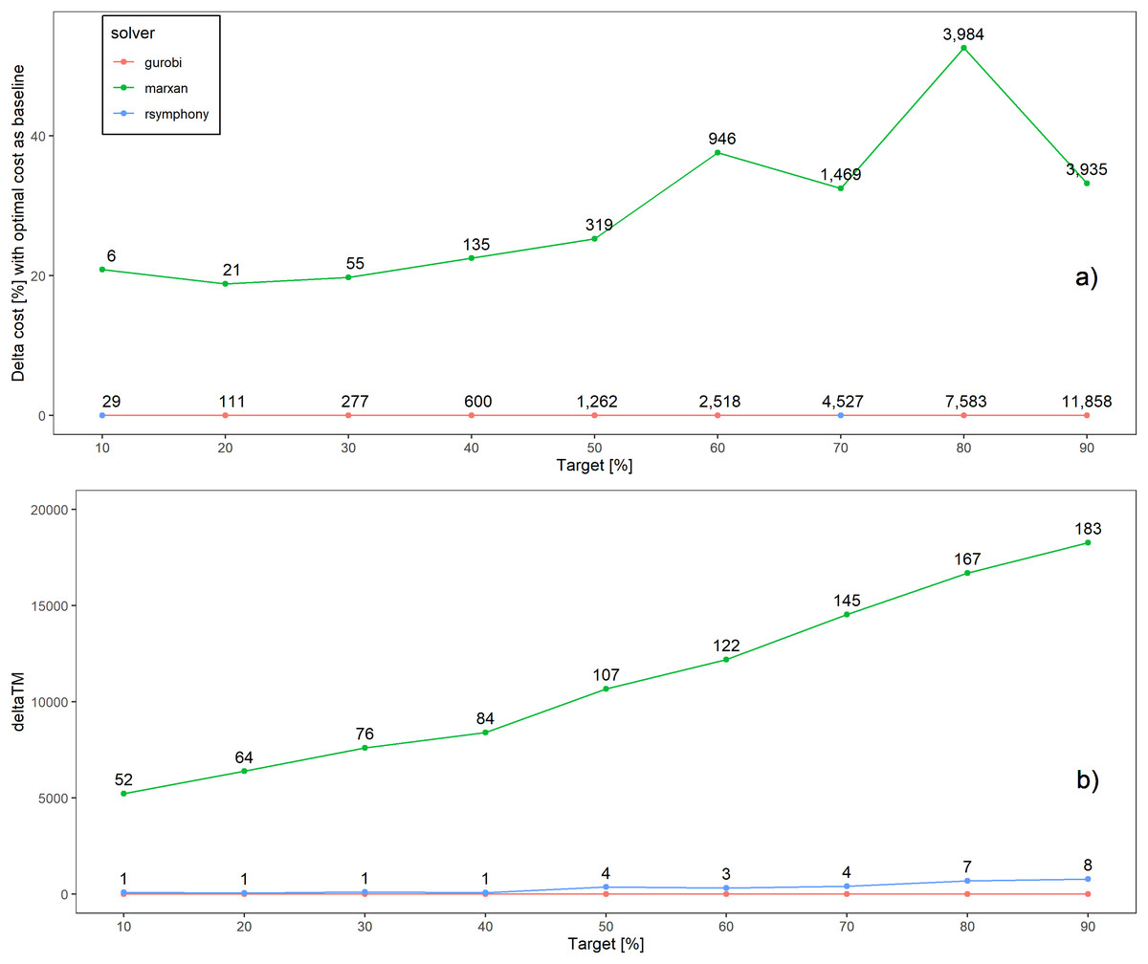
Better solutions
Better solution quality
Schuster et al. 2020 PeerJ

Slide 30
Faster too!
183x slower
Slower run time
52x slower
Schuster et al. 2020 PeerJ

Slide 31
Project prioritization
Project data
Recovery projects

Slide 32




Feature data
Phylogenetic data
Stakeholder weights
Project prioritization
Project data
Cost data
Actions
$
$$
$$$
Recovery projects
$0

Slide 33
Project prioritization
Feature data
Phylogenetic data
Stakeholder weights
Project data
Cost data
Actions
$
Success
$$
90%
$$$
20%
Recovery projects
$0
50%
100%

Slide 34
Project prioritization
Feature data
Phylogenetic data
Stakeholder weights
Project data
Cost data
Actions
Persistence (%)
$
Success
$$
90%
95%
$$$$$
20%
10%
Recovery projects
$0
50%
70%
100%
40%
9%
65%

Slide 35
Project prioritization
Feature data
Phylogenetic data
Stakeholder weights
Project data
Cost data
Actions
Persistence (%)
$
Success
$$
90%
95%
$$$
20%
10%
Recovery projects
$0
50%
70%
Budget
$$$
100%
40%
9%
65%

Slide 36
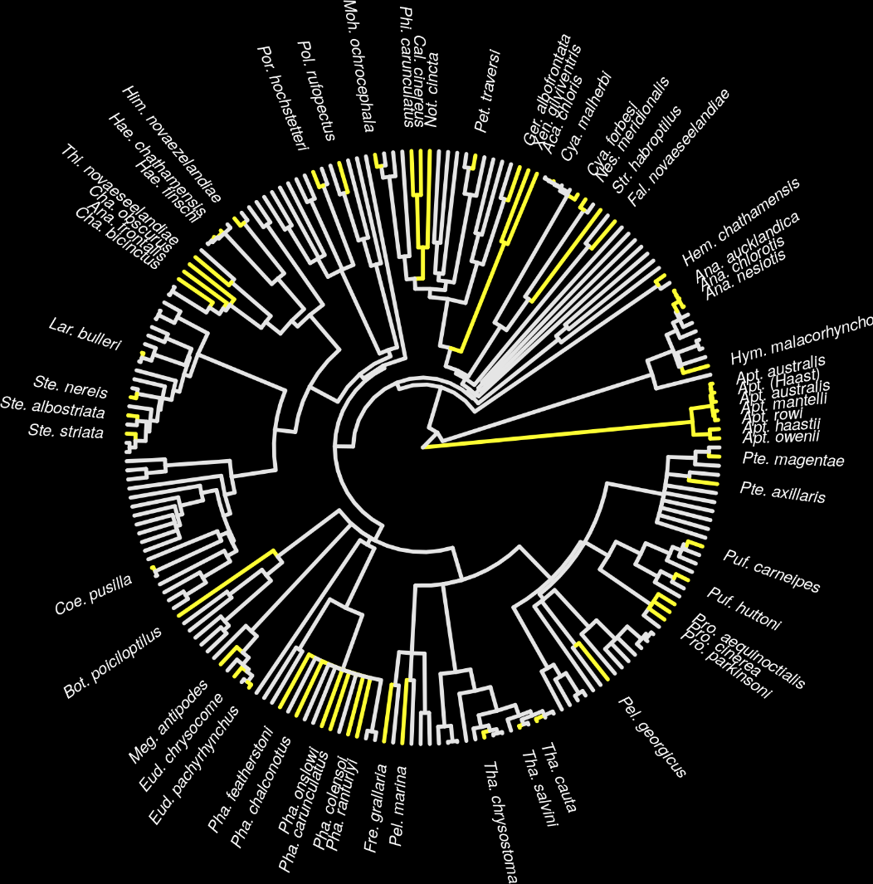
New Zealand case study
Projects for 62 imperilled bird species
1,218 different actions
Many actions shared between projects for different species
oppr R package on CRAN
Hanson et al. (2019) Methods Ecol Evol , DOI:10.1111/2041-210X.13264

Slide 37
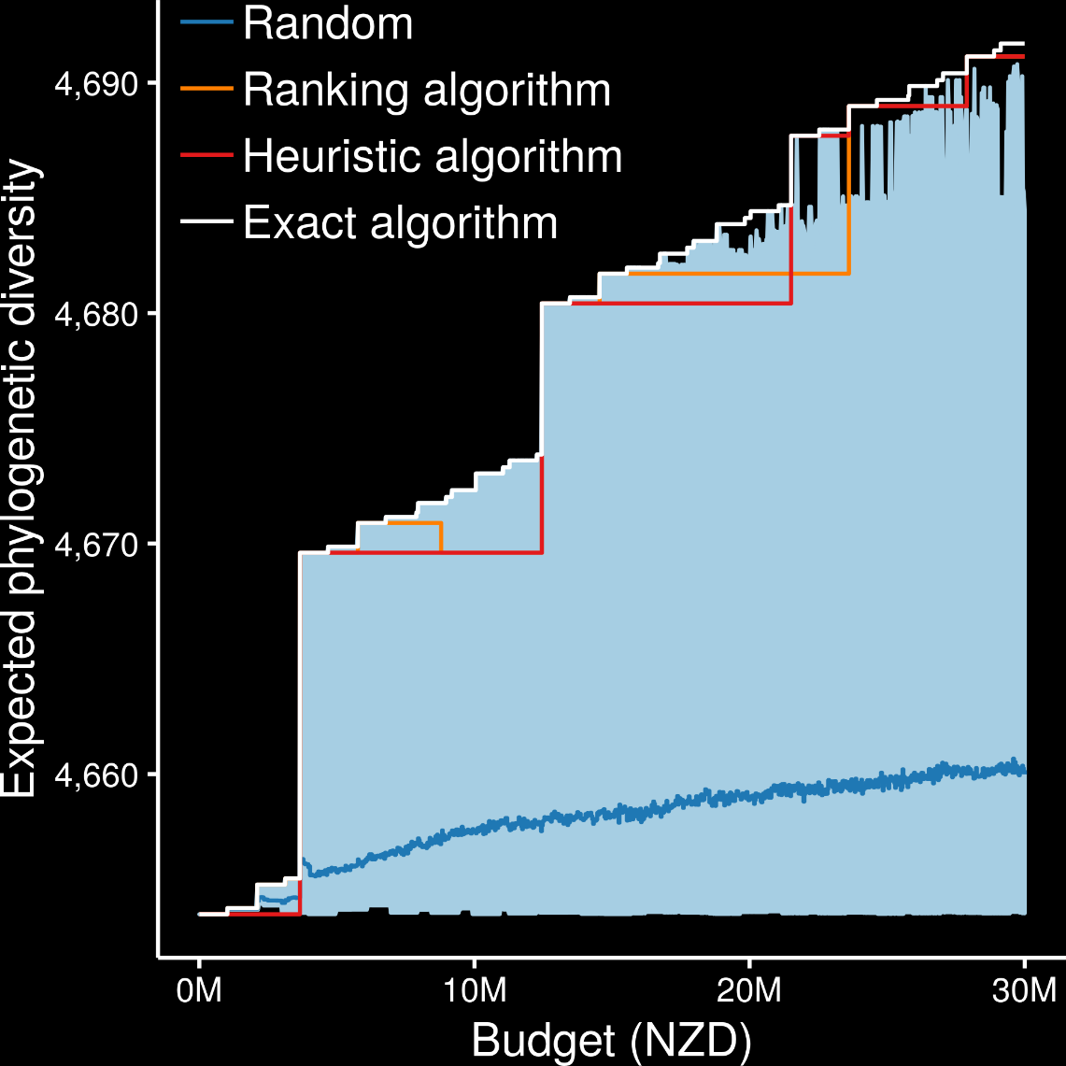
Exact algorithms always generated the best prioritizations
Hanson et al. (2019) Methods Ecol Evol , DOI:10.1111/2041-210X.13264

Slide 38
Ranking and heuristic algorithms sometimes produced optimal prioritizations
Ranking and heuristic algorithm sometimes produced sub-optimal prioritizations
Hanson et al. (2019) Methods Ecol Evol , DOI:10.1111/2041-210X.13264

Slide 39
Ranking and heuristic algorithms sometimes produced worse prioritizations than randomly allocating funds
Ranking and heuristic algorithms often had large amounts of unspent funding, meaning less guidance for decision making
Hanson et al. (2019) Methods Ecol Evol , DOI:10.1111/2041-210X.13264

Slide 40




jeffrey.hanson@uqconnect.edu.au
github.com/jeffreyhanson
jeffrey-hanson.com

Slide 41
Case-study: Sandwich
Goal: Best sandwich experience
Objective: Maximize taste
Constraints:
must have 2 slices of bread,
total calories for the meal must not be too high,
total cost of ingredients must not exceed budget
Decisions: which ingredients shall I use?

Slide 42
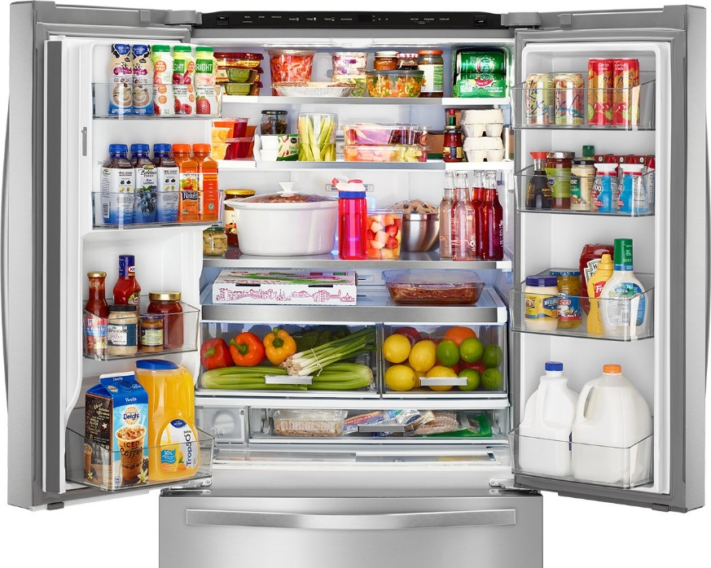
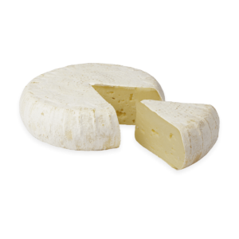
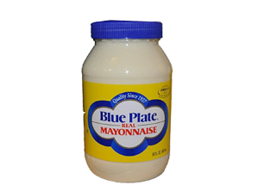
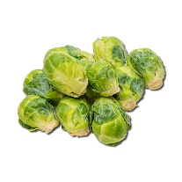
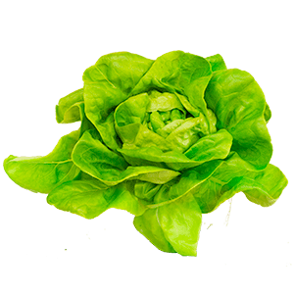
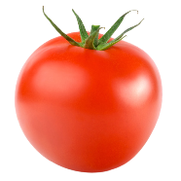


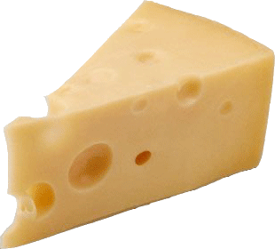

Slide 43
Maximize taste:
+1
+50
+20
+40
+3
+1
+8
-1

Slide 44
Maximize taste:
+1
+50
+20
+40
+3
+1
+8
-1
Constraint 1: must have 2 bread slices
+1
+0
+0
+0
+0
+0
+0
+0
=1

Slide 45
Maximize taste:
+1
+50
+20
+40
+3
+1
+8
-1
Constraint 1: must 2 bread slices
+1
+0
+0
+0
+0
+0
+0
+0
=1
Constraint 2: calories (C per serving)
+70
+145
+380
+299
+15
+680
+24
43
≤235

Slide 46
Maximize taste:
+1
+50
+20
+40
+3
+1
+8
-1
Constraint 1: must 2 bread slices
+1
+0
+0
+0
+0
+0
+0
+0
=1
Constraint 2: calories (C per serving)
+70
+145
+380
+299
+15
+680
+24
43
≤235
Constraint 3: budget (€ per serving)
+0.21
+2.5
+0.12
+0.84
+0.04
+0.04
+0.08
+0.07
≤2.75

Slide 47
Maximize taste:
+1
+50
+20
+40
+3
+1
+8
-1
Constraint 1: must 2 bread slices
+1
+0
+0
+0
+0
+0
+0
+0
=1
Constraint 2: calories (C per serving)
+70
+145
+380
+299
+15
+680
+24
43
≤235
Constraint 3: budget (€ per serving)
+0.21
+2.5
+0.12
+0.84
+0.04
+0.04
+0.08
+0.07
≤2.75

Slide 48
Maximize taste:
+1
+50
+20
+40
+3
+1
+8
-1
Constraint 1: must 2 bread slices
+1
+0
+0
+0
+0
+0
+0
+0
=1
Constraint 2: calories (C per serving)
+70
+145
+380
+299
+15
+680
+24
43
≤235
Constraint 3: budget (€ per serving)
+0.21
+2.5
+0.12
+0.84
+0.04
+0.04
+0.08
+0.07
≤2.75

Slide 49

Maximize taste:
+1
+50
+20
+40
+3
+1
+8
-1
Constraint 1: must 2 bread slices
+1
+0
+0
+0
+0
+0
+0
+0
=1
Constraint 2: calories (C per serving)
+70
+145
+380
+299
+15
+680
+24
43
≤235
Constraint 3: budget (€ per serving)
+0.21
+2.5
+0.12
+0.84
+0.04
+0.04
+0.08
+0.07
≤2.75

Slide 50
Maximize taste:
+1
+50
+20
+40
+3
+1
+8
+20
Constraints 2--3
Constraint 4: mayo + lettuce combination
+0
+0
+0
+0
+0
+1
+0
-1
≥0
+0
+0
+0
+0
+1
+0
+0
-1
≥0

Slide 51
Performance for phylogenetic diversity
Exact algorithms generated prioritizations within a feasible period of time
Heuristic and ranking algorithms are faster
It might be worth waiting worth ~15 seconds if it means you could potentially save millions of $$$
Table: Average run time for generating prioritizations under different budgets
Algorithm | Average run time (seconds)
Exact | 16.2
Heuristic | 1.19
Ranking | 1.5
NB. Heuristic and ranking algorithms coded in C++ for performance, so if you’re using R, these timings would be much higher
Hanson et al. (2019) Methods Ecol Evol , DOI:10.1111/2041-210X.13264

Slide 52
Performance for total expected persistence
Simulated dataset
40 conservation projects
80 management actions
50 species
Table: Average run time for generating prioritizations under different budgets
Algorithm | Average run time (seconds)
Exact | 1.6
Heuristic | 1.48
Ranking | 1.18
Performance of exact algorithm solver is pretty much the same for simple problems
NB. Heuristic and ranking algorithms coded in C++ for performance, so if you’re using R, these timings would be much higher
Hanson et al. (2019) Methods Ecol Evol , DOI:10.1111/2041-210X.13264

